Slide 1
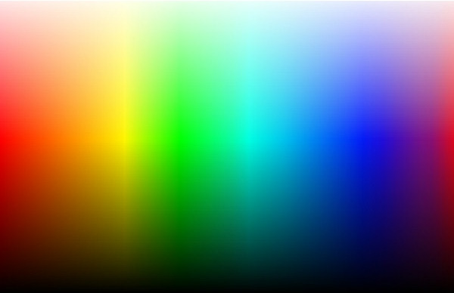
Lecture 6: Color in Design
Neil H. Schwartz, Ph.D.
Senior Seminar in Visualization

Slide 2
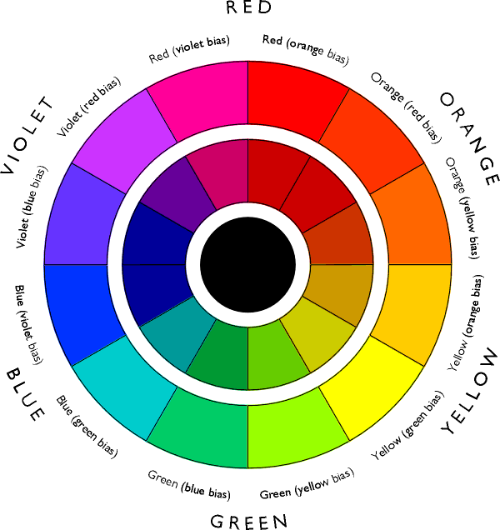

Slide 3
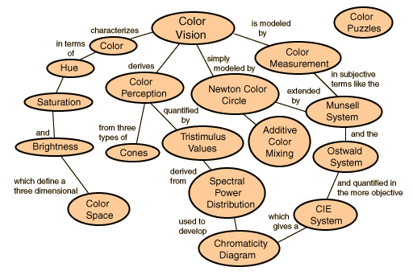
Color-Processing in Vision

Slide 4
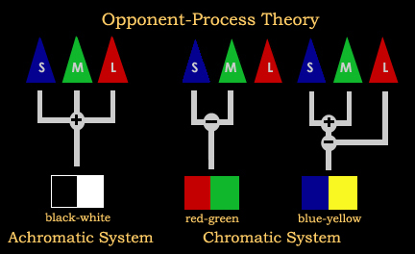
Two Major Theories of Color Vision
Trichromatic Theory
Opponent-Process Theory

Slide 5
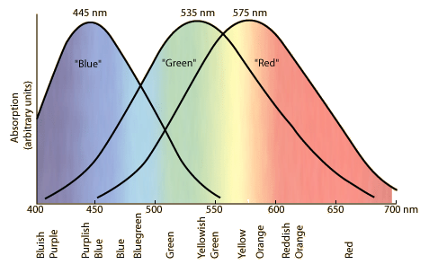
Trichromatic Theory
Cone receptors process color.
There are 3 types of color-sensitive cones in the retina.
Light Response Curve
Peak responsivity

Slide 6
Color-Processing in Vision
Long wavelength
Short wavelength
BLUE CONES
2% OF THE CONE POPULATION
Found mostly outside the fovea
Blue cone sensitivity is equal to the others, so it must have a boosting mechanism.
Light Response Curve
Peak responsivity
Height is unknown
GREEN CONES
32% OF THE CONE POPULATION
Packed into the fovea centralis.
How much of the particular
part of the color spectrum is
absorbed by the 3 types
of cones.
RED CONES
64% OF THE CONE POPULATION
Packed into the fovea centralis.
Nanometers

Slide 7
RED GREEN BLUE
Trichromatic Theory [RGB Cone excitation] does not explain how all color is seen.
How do we see magenta?
Why don’t we see reddish green?
How do we see yellow?
How do we see turquoise?
Why don’t we see yellowish blue?
Why do we see an after-image of green, when looking at red?

Slide 8
Opponent Process Theory
Color perception is controlled by the activity of three opponent systems:
Color perception works through a process of excitatory and inhibitory responses, with the two components of each mechanism opposing each other.
Red creates a positive (or excitatory) response while green creates a negative (or inhibitory) response. It is the difference that gives the color.
These responses are controlled by opponent neurons-- neurons that have an excitatory response to some wavelengths and an inhibitory response to wavelengths in the opponent part of the spectrum.
luminance only

Slide 9
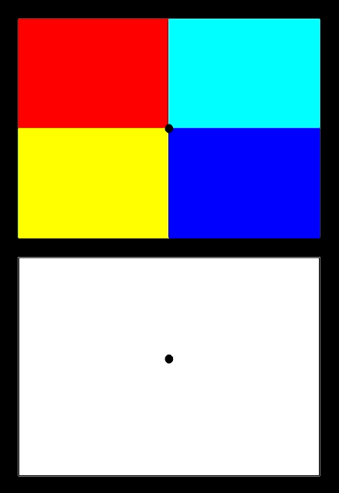

Slide 10
Which Theory Then?
BOTH
The trichromatic theory explains color vision phenomena at the photoreceptor level.
The opponent-process theory explains color vision phenomena that result from the way photoreceptors are interconnected neurologically.

Slide 11
Visual Properties of Opponent Process Theory

Slide 12
Simultaneous Contrast
SC is a distortion of the appearance of a patch of color in a way that increases the difference between a color and its surroundings.
Two colors, side by side, interact with one another and change our perception accordingly. The effect of this interaction is called simultaneous contrast. Since we rarely see colors in isolation, simultaneous contrast affects our sense of the color that we see.

Slide 13
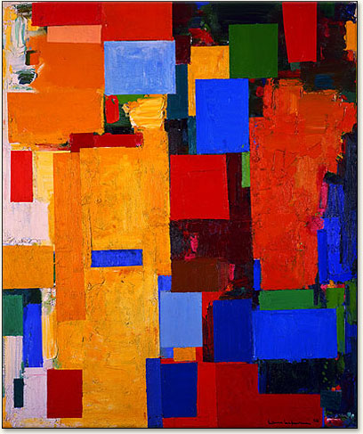
Simultaneous Contrast
Simultaneous contrast is most intense when the two colors are complementary colors.
Sensation is the most intense where two extremes are juxtaposed.

Slide 14
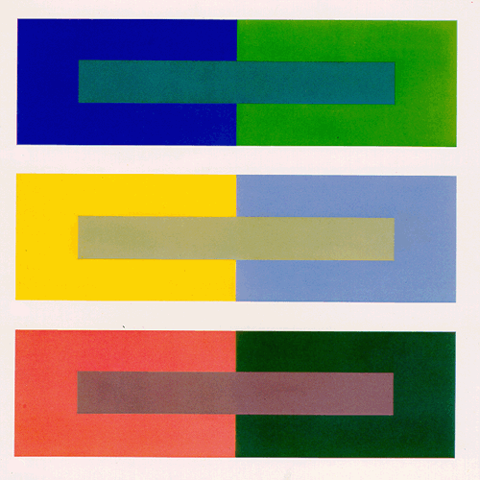
Simultaneous Contrast
This is called chromatic contrast when it occurs in the either the red-green or the yellow-blue channel.

Slide 15
Simultaneous Contrast
This is called lightness or brightness contrast when it occurs in the black-white. (luminance)

Slide 16
Simultaneous Contrast
Contrast occurs because the visual system is better at determining differences between colors, rather than how much light is actually reflected.
A magnificent website for simultaneous contrast and art.
http://www.webexhibits.org/colorart/contrast.html

Slide 17
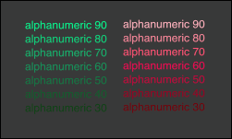
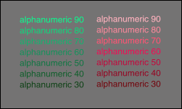
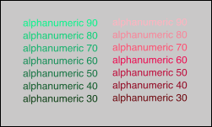
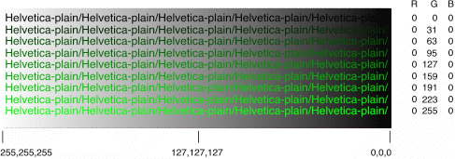
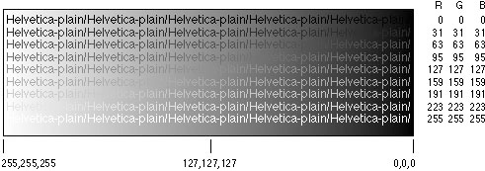
There are functional benefits between Chromatic contrast and Luminance contrast

Slide 18
Luminance contrast is better for showing
1. Detail
2. Motion
3.Stereoscopic depth
4. Determining shape from shading
5. The contrast must be at least 3:1

Slide 19
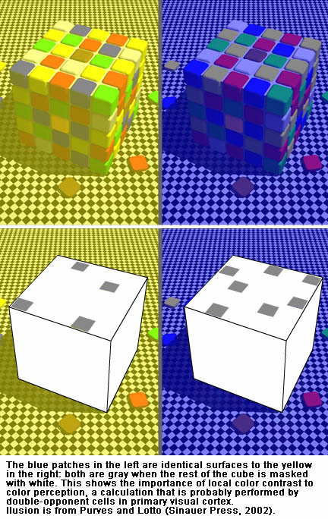
Color Detection & Identification
The appearance of a color is affected by the colors that surround it, its orientation with respect to the source of light, whether it is perceived as being in or out of a shadow, the texture of the surface on which it lies, etc.

Slide 20
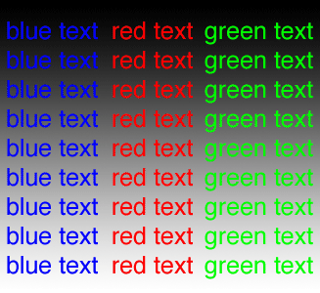
Principles for Design: Color and Detail
When using color, luminance contrast is essential for showing detailed information.
As graphical features get larger, the need for extreme luminance contrast declines.
Luminance contrast is critical for small text.

Slide 21
Principles for Design: Color Coding Information
The most important use of color is to indicate categories of information.
Two primary considerations are:
Visual distinctness
Learnability
With complex designs and small symbols, the limit of symbols = 12.
6 – 12 symbols can be used in a symbol set.

Slide 22
Principles for Design: Emphasis & Highlighting

Slide 23
Principles for Design: Color Sequencing

Slide 24
Principles for Design: Semantics of Color

